Slide 1

HAAPEN
HA
HAAPEN
Azmia Hoque Radhio
ID : 171-35-1932

Slide 2

Introduction
In our real-life scenario, we work in many projects or somehow involved in many projects, but in an undisciplined way. We do not maintain our workflow or keep tracks so we cannot see the project overview Or current state we’re in, team collaboration also done in a messy way. So, the project named ‘HAAPEN’ helps us to create projects and associate individuals and distribute tasks or collaborate and keep track, all in one place

Slide 3

Requirement Analysis:
User Category:
There are 2-types of Users here. They are:
Project Manager
Project Members

Slide 4
Feature List:
Project Manager
Project Members
Create a plan/project or approve the project
Add or Remove individuals permanently
Fixes deadline for the tasks
Commenting with member (issues)
Can see projects he got assigned into.
Can see task boards of the projects
Can see the tasks card per board
Can submit a proposal to admin.
Commenting with admin (issues)
get mail for assigning every task/project and deadline

Slide 5
Functional Requirements
A project manager may use the software to map project tasks and visually describe task interactions.
Allows the project manager to create and assign tasks, establish deadlines, and produce status reports.
The software must have the ability to send email to project member for assigning every task/project and deadline
The software must have the ability to Commenting with member and manager with each other.

Slide 6
Non-functional requirements
Members never allowed to update their Project information.
This software should be capable enough to handle 100 users without affecting its performance
Privacy of information, the export of restricted technologies, intellectual property rights, etc. should be audited.
Add a footer

Slide 7
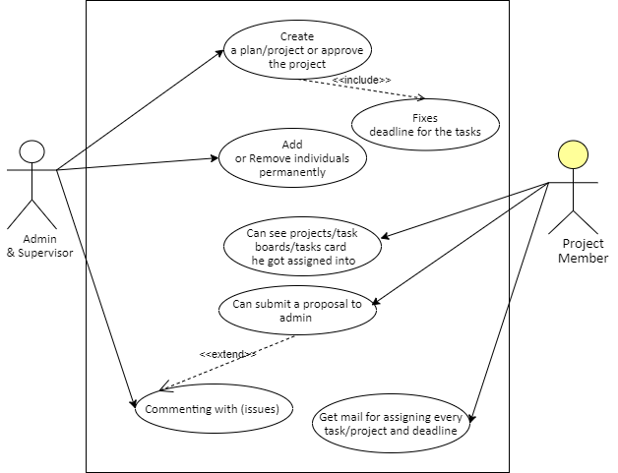
Use-case Diagram
Add a footer

Slide 8
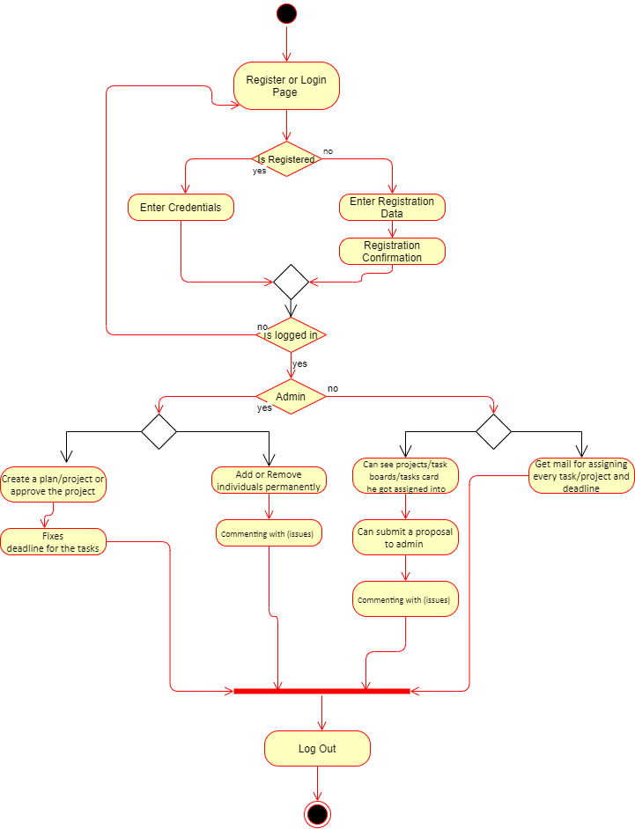
Activity Diagram
Add a footer

Slide 9
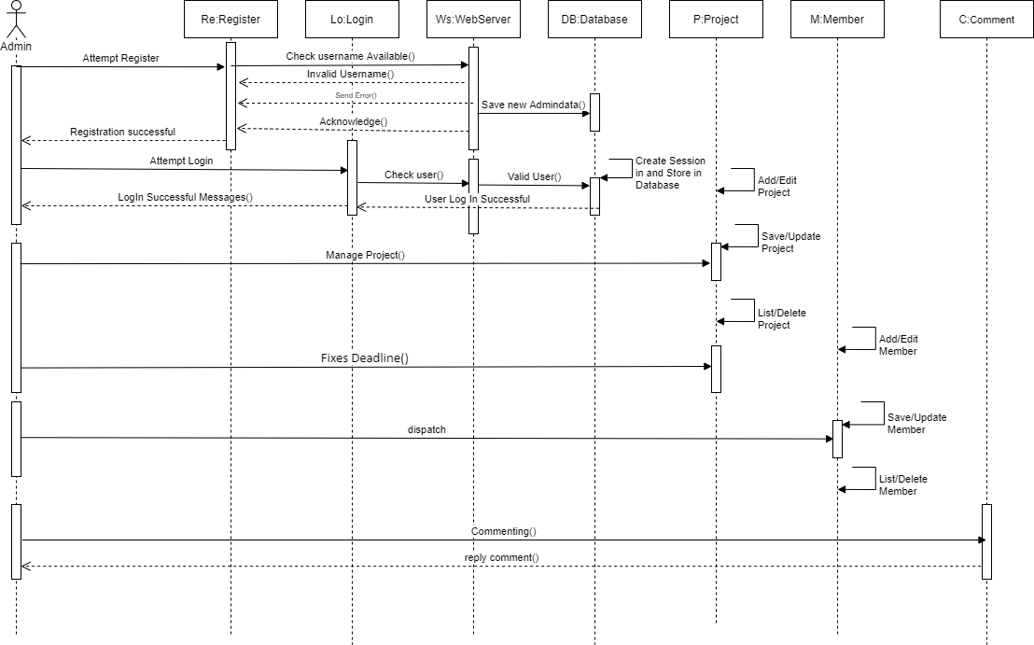
Sequence Diagram for Manager
Add a footer

Slide 10
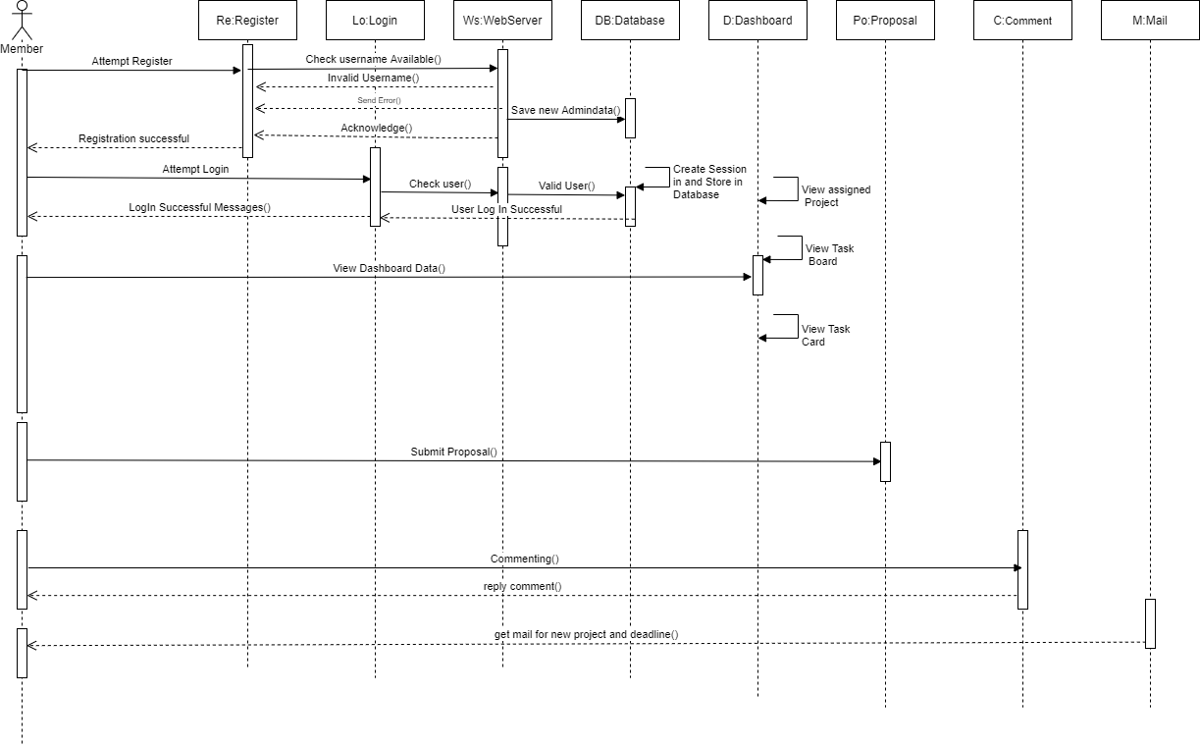
Sequence Diagram for Member
Add a footer

Slide 11
Sequence Diagram for Member
Add a footer

Slide 12
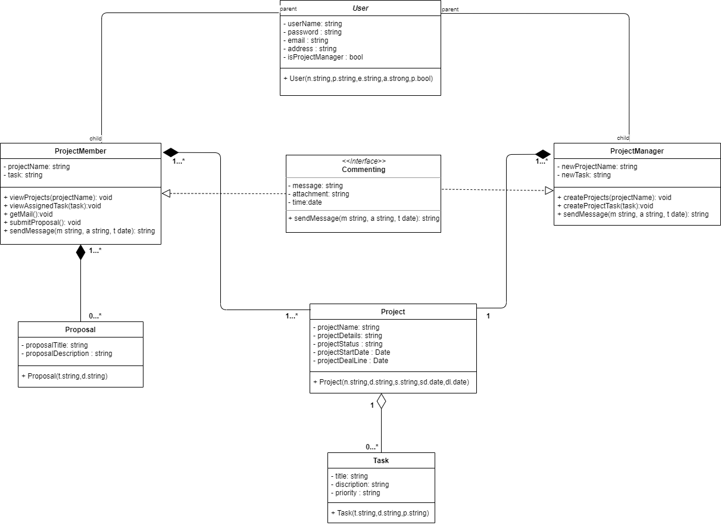
Class Diagram
Add a footer

Slide 13
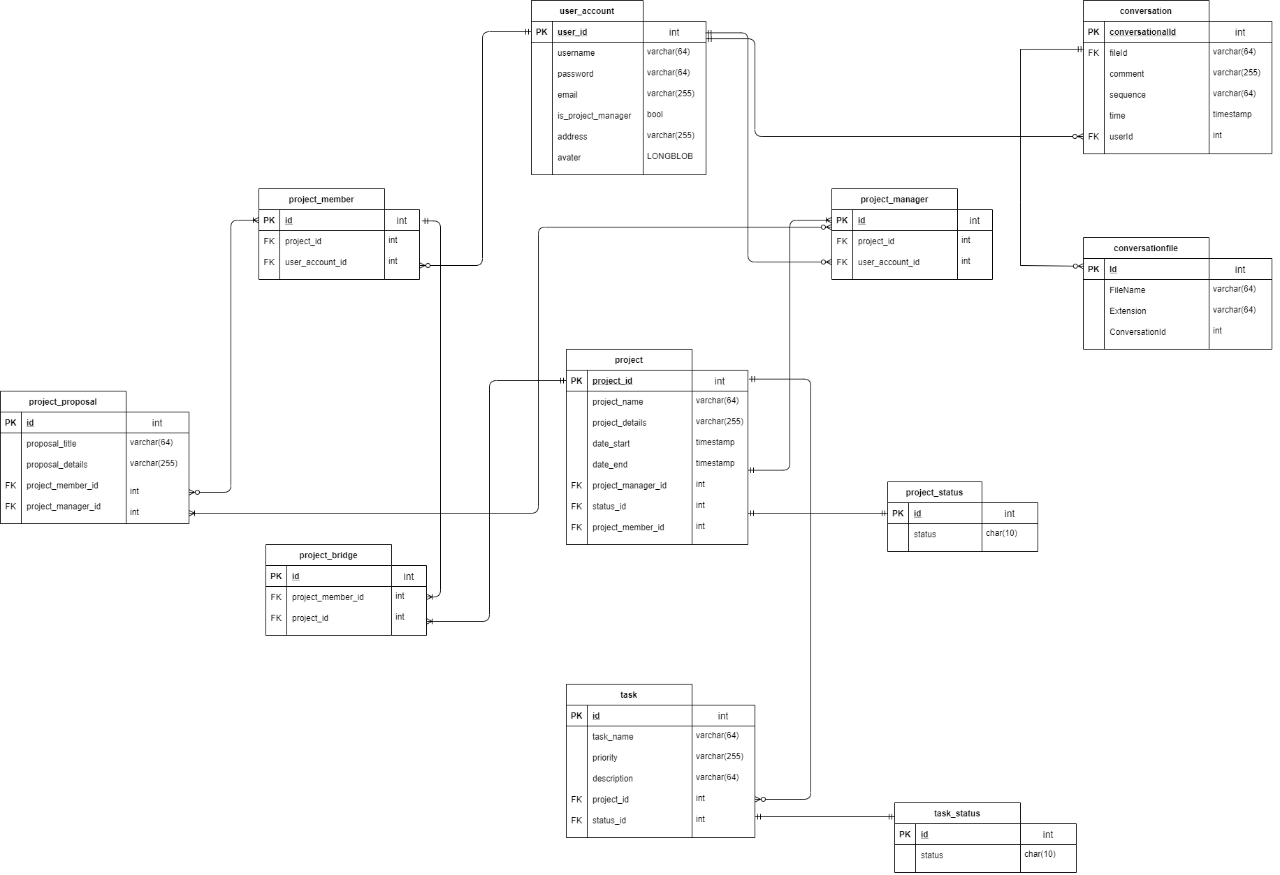
Entity relationship diagram
Add a footer

Slide 14
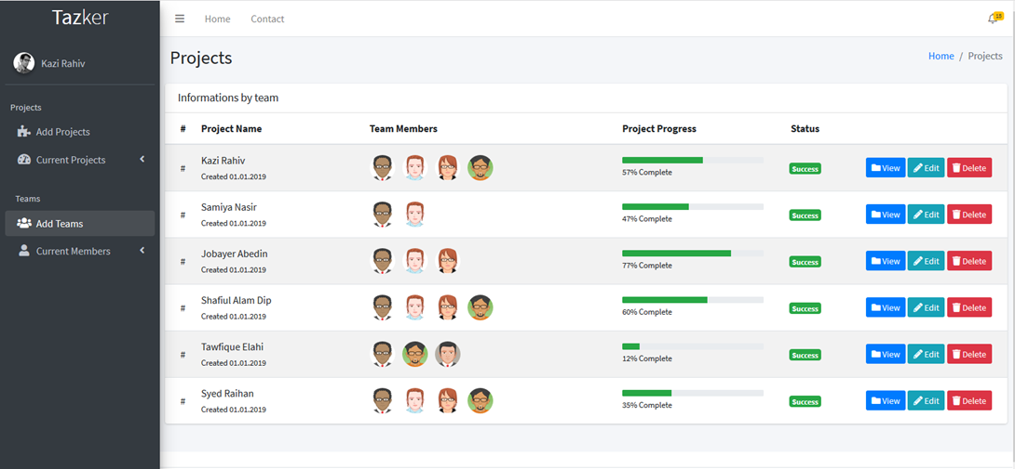
System Images against the Specification for Admin:
Add a footer

Slide 15
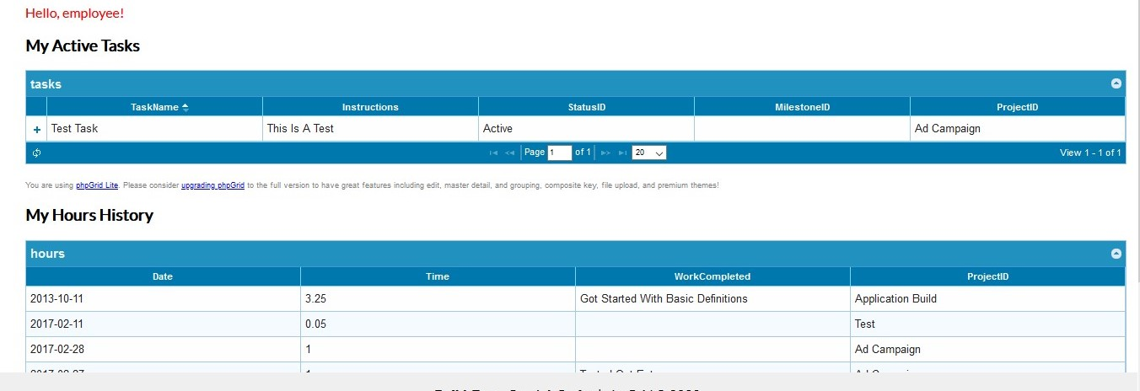
System Images against the Specification for Member:
Add a footer

Slide 16
Technology:
Client-side : HTML CSS and Bootstrap
Server-side: ASP .net core
DBMS : My SQL
Conclusion with Future work plan:
API integration for extending and use information from this application to others.
Breaking down this project into microservices for scalability and larger improvements.
Payroll implementation
Payment gateway implementation.
Mobile application version for managing on the go!
Add a footer

Slide 17
Thank You.
HA
Azmia Hoque Radhio
HAPPAN
171-35-1932
azmia35-1932@diu.edu.bd
www.radhiopy.com

